Slide 1
Key logger and security
CAPSTONE PROJECT
Presented By:
1. DIVYA R-JKKNCET-B.Tech-IT

Slide 2
OUTLINE
Problem Statement (Should not include solution)
Proposed System/Solution
System Development Approach (Technology Used)
Algorithm & Deployment
Result (Output Image)
Conclusion
Future Scope
References

Slide 3
Problem Statement
In today's digital age, where cybersecurity threats loom large, one of the significant concerns is the proliferation of keyloggers, stealthy software tools designed to monitor and record keystrokes on a user's computer without their knowledge. Keyloggers pose a severe threat to individuals and organizations as they can capture sensitive information such as passwords, credit card details, and other personal data, leading to identity theft, financial loss, and privacy breaches.

Slide 4
Proposed Solution
To mitigate the risk of keyloggers and enhance cybersecurity, here are several solutions individuals and organizations can implement:
Use Antivirus and Anti-Malware Software: Install reputable antivirus and anti-malware software on your computer systems. These programs can detect and remove keyloggers and other malicious software.
Keep Software Updated: Regularly update your operating system, antivirus software, web browsers, and other applications. Software updates often include security patches that address vulnerabilities that could be exploited by keyloggers.

Slide 5
Proposed Solution
Practice Safe Browsing Habits: Be cautious when visiting websites, downloading files, or clicking on links in emails. Only visit trusted websites and be wary of suspicious emails, pop-ups, or attachments that may contain keyloggers.
Use a Firewall: Enable a firewall on your computer to monitor and control incoming and outgoing network traffic. Firewalls can help block unauthorized access attempts, including attempts by keyloggers to transmit captured data.
Employ Two-Factor Authentication (2FA): Enable two-factor authentication whenever possible. This adds an extra layer of security by requiring a second form of verification, such as a unique code sent to your mobile device, in addition to your password.
Be Cautious with Public Computers: Avoid using public computers or untrusted devices for sensitive tasks, such as accessing online banking or entering passwords. Public computers may have keyloggers or other malicious software installed.

Slide 6
Proposed Solution
Use Virtual Keyboards: When entering sensitive information, such as passwords or credit card details, consider using an on-screen virtual keyboard. Virtual keyboards allow you to input characters by clicking on them with a mouse, making it more difficult for keyloggers to capture keystrokes.
Regularly Monitor Accounts and Transactions: Keep a close eye on your financial accounts and regularly review your transactions for any suspicious activity. If you notice any unauthorized charges or unusual behavior, report it immediately.
Educate and Train Employees: Organizations should provide cybersecurity awareness training to employees. This includes educating them about the risks of keyloggers, phishing attacks, and other common threats. Employees should be trained to recognize and report suspicious activities.
Physical Security Measures: For organizations, physical security measures are also important. Limit physical access to computers and ensure that workstations are locked when unattended. This prevents unauthorized individuals from installing keyloggers or accessing sensitive information directly.

Slide 7
System Approach
The "System Approach" section outlines the overall strategy and methodology for developing and implementing the rental bike prediction system. Here's a suggested structure for this section:
Risk Assessment
Security Policy
Network Security
Endpoint Protection
Secure Configuration

Slide 8
Algorithm & Deployment
Algorithm:
Data Collection: Gather keystroke data from the user's input, such as keyboard events or operating system APIs that capture keystrokes.
Preprocessing: Preprocess the collected keystroke data to remove noise and irrelevant information. This may include removing keystrokes from specific applications or handling special cases like key combinations (e.g., Ctrl+C).
Feature Extraction: Extract relevant features from the preprocessed keystroke data. These features can include key press durations, inter-key intervals, typing rhythms, and patterns.
Training Phase: Use a machine learning algorithm, such as a supervised classification algorithm, to train a model using a labeled dataset. The labeled dataset should consist of examples of keystroke data labeled as either normal or keylogger activity.
Model Building: Build a model based on the training phase, which can classify keystroke data as normal or suspicious/keylogger activity.
Real-time Detection: In the real-time detection phase, continuously monitor the user's keystrokes and apply the trained model to classify incoming keystroke data. If the model detects suspicious activity, it raises an alert or takes appropriate action.

Slide 9
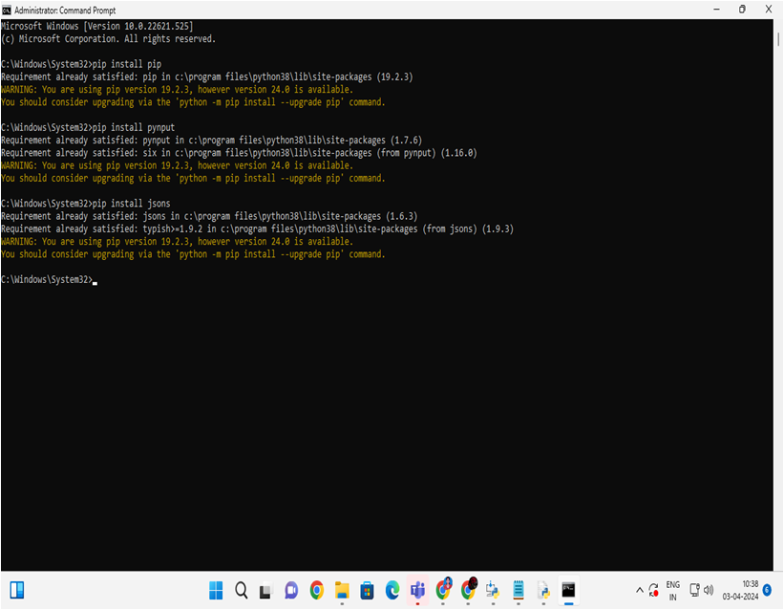
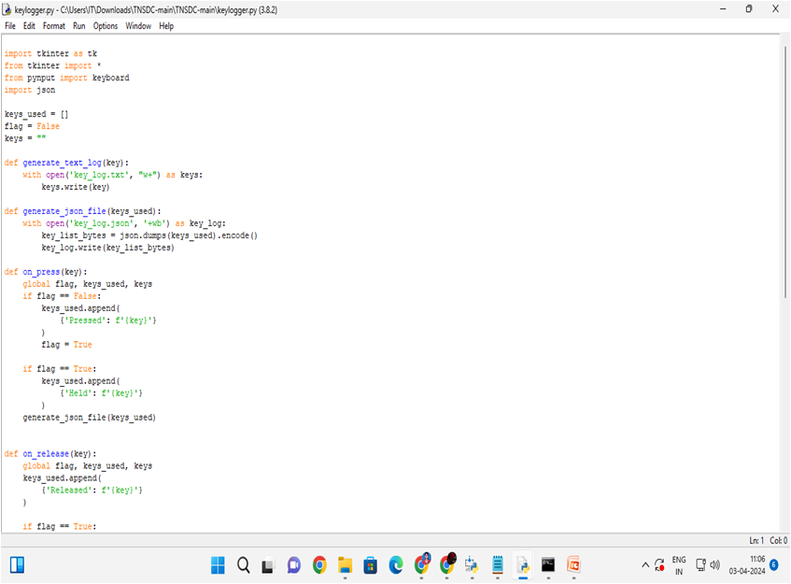
Algorithm & Deployment

Slide 10
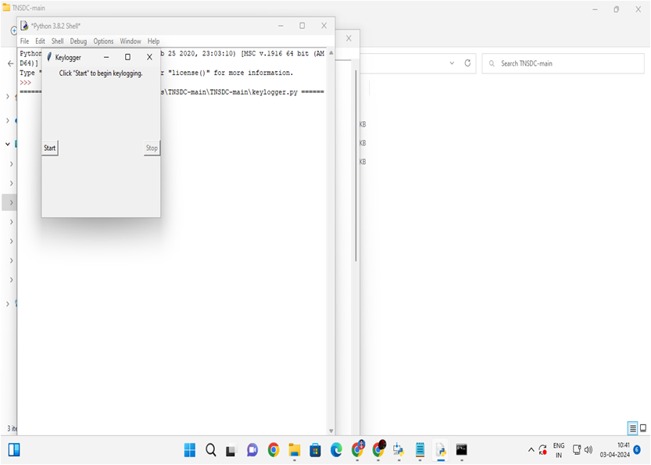

Result

Slide 11
Conclusion
In conclusion, by implementing a multi-layered approach including robust security measures, user awareness, and proactive monitoring, organizations and individuals can effectively mitigate the risk of keyloggers, safeguard sensitive information, and enhance overall cybersecurity.

Slide 12
Future scope
In the future, advancements in artificial intelligence and machine learning may enable more sophisticated keylogger detection algorithms capable of identifying subtle patterns and behaviors, further enhancing the protection against evolving keylogger techniques.

Slide 13
References
In today's digital age, keyloggers pose a significant threat to cybersecurity, allowing attackers to clandestinely record keystrokes and steal sensitive information without the user's knowledge (Gollmann, 2006).

Slide 14
THANK YOU

